Slide 1
LOAN DATA ANALYSIS

Slide 2
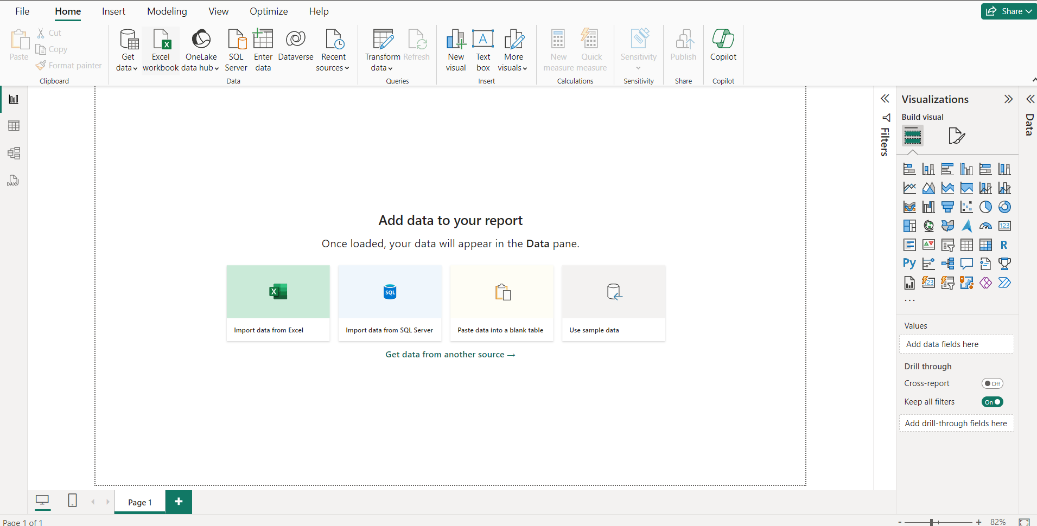
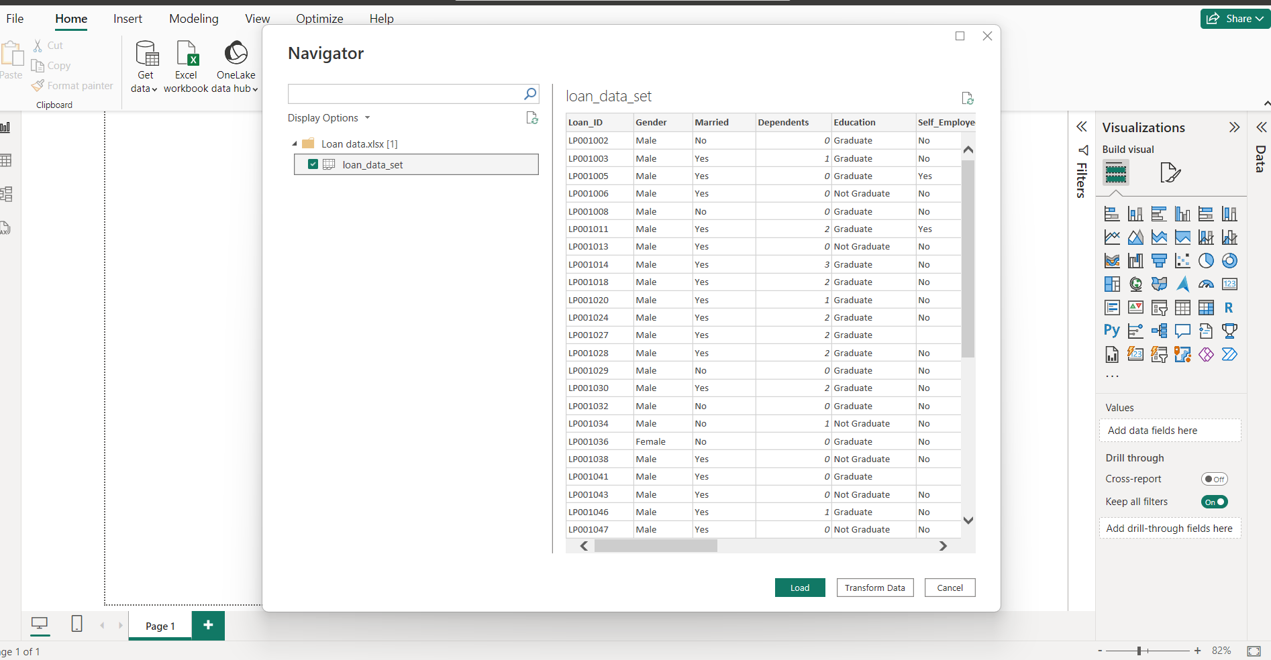
IMPORT DATA
Open Power BI
Select import data from excel.
Select file and open the data.
Then click the sheet 1 check box and click transform data.

Slide 3
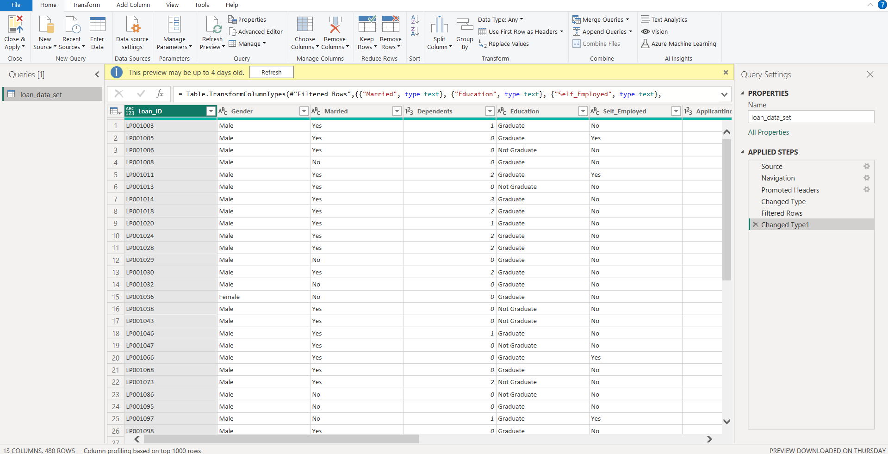
TRANSFORM DATA
We can change the type of data and modify here.
We filter the rows with null values.
We can view the changes we done in the right side.
Finally select close and apply to save the changes.

Slide 4
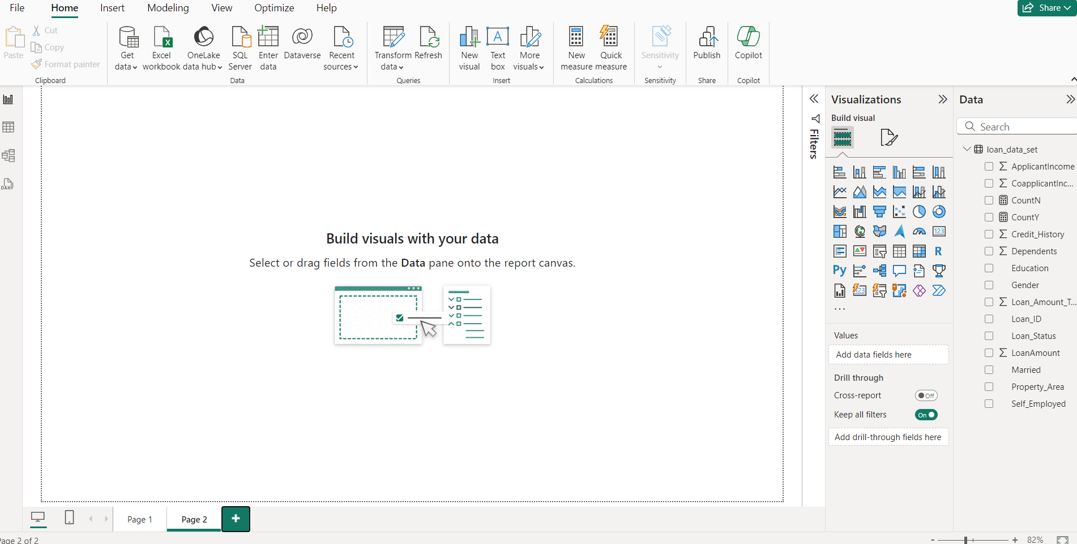
VISUALIZATION
Now, we get the data.
Next, we create the visualization.
Click Home → New visual.
Then select the type of visual from the visualizations.

Slide 5
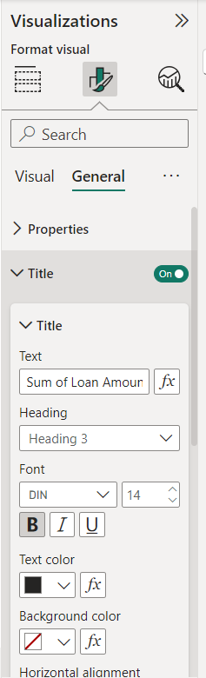
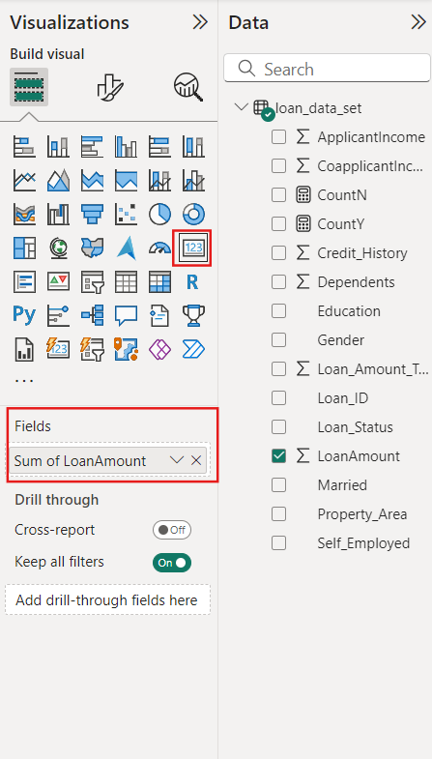
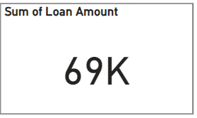
SUM OF LOAN AMOUNT
First we click cards from the visualization and sum of loan amount in fields.
Then change the format from the format visual.

Slide 6
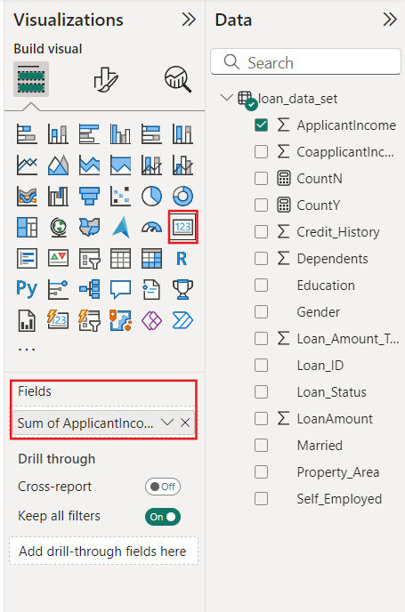
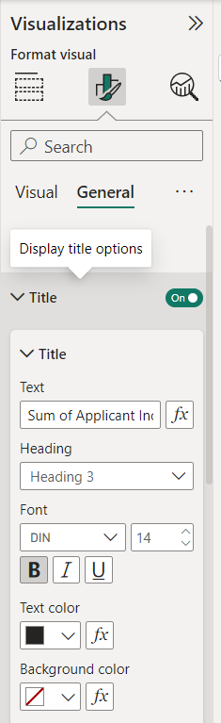
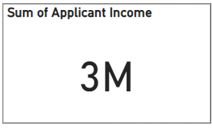
SUM OF APPLICANT INCOME
We click cards from the visualization and sum of applicant income in fields.
Then change the format from the format visual.

Slide 7
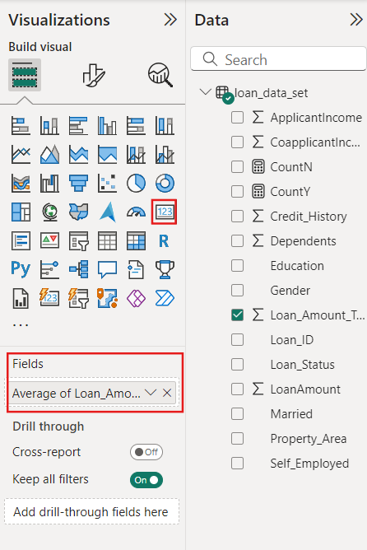
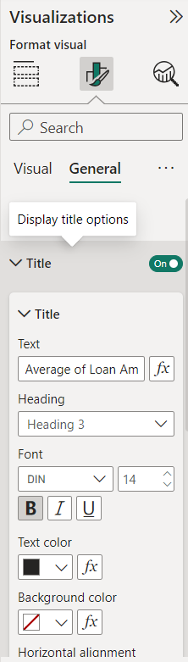
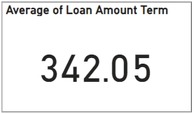
AVERAGE OF LOAN AMOUNT TERM
We click cards from the visualization and average of loan amount term in fields.
Then change the format from the format visual.

Slide 8
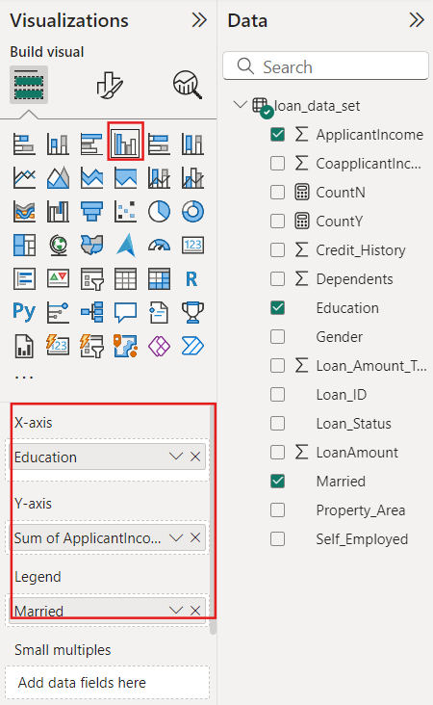
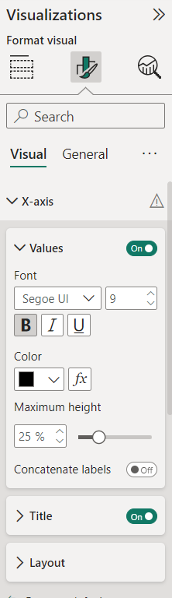
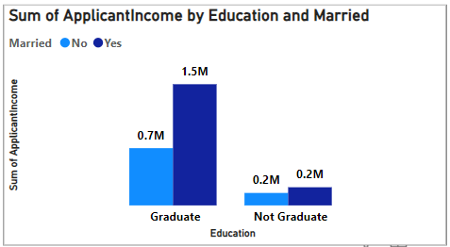
SUM OF APPLICANT INCOME BY EDUCATION AND MARRIED
We select clustered column chart.
Then drag education in x axis and sum of applicant income in y axis and married in legend.
We can change the format of the visual.

Slide 9
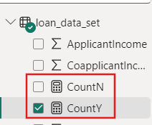
NEW MEASURE
We click gauge on the visualizations.
We find the count of y and N in loan status.
We create a new measure.
Click table tools → New measure.
CountY = CALCULATE(COUNTROWS('loan_data_set'),'loan_data_set'[Loan_Status]="Y")
CountN = CALCULATE(COUNTROWS('loan_data_set'),'loan_data_set'[Loan_Status]="Y")

Slide 10
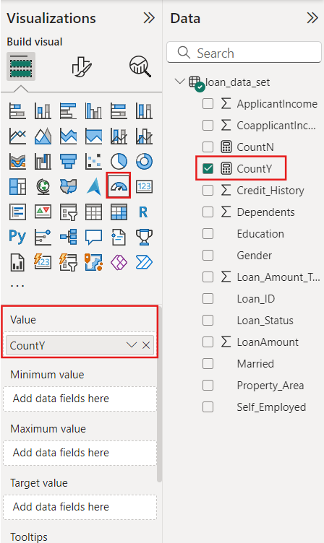
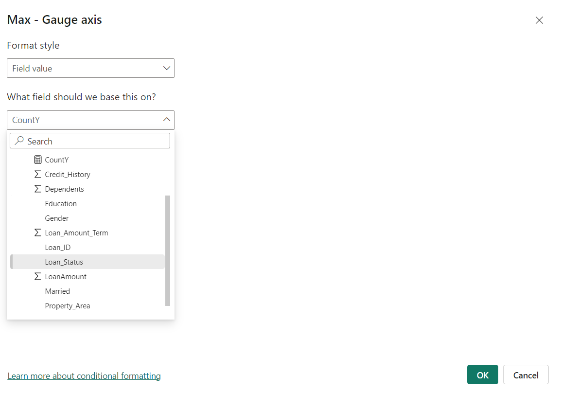
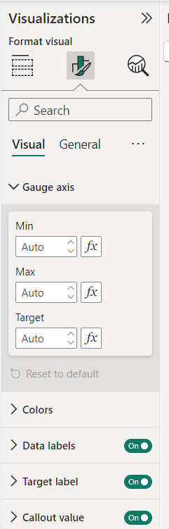
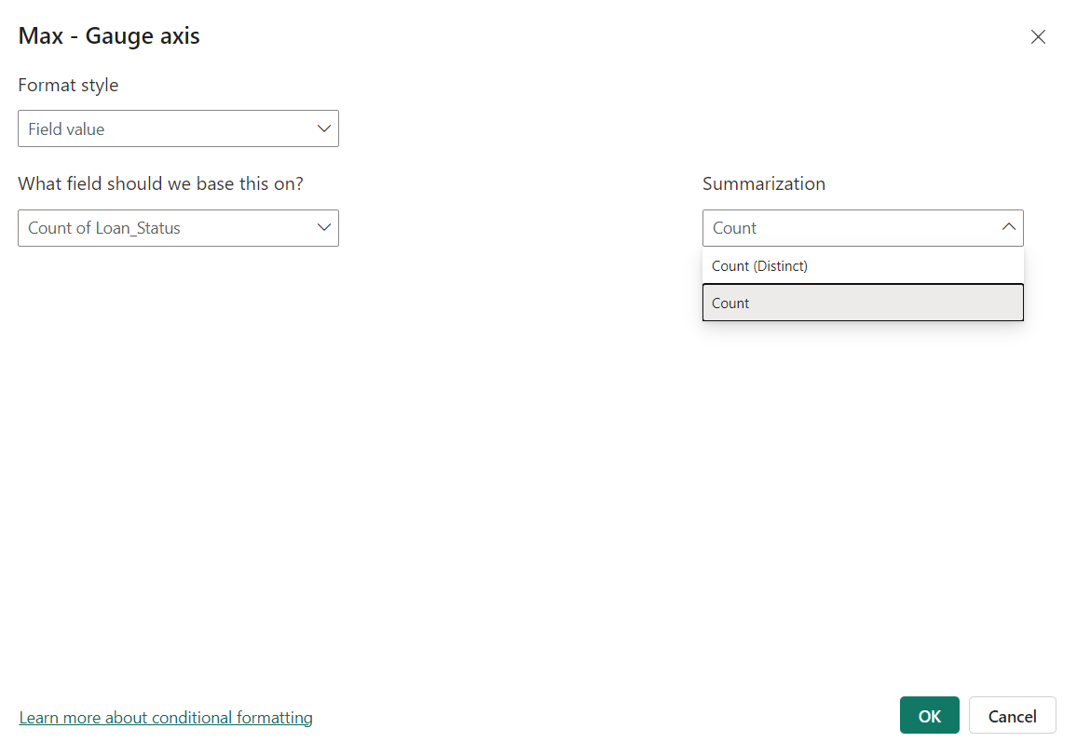
GAUGE AXIS
Then drag countY in values.
Click format visual → Gauge axis → Max(fx) → Loan status→count→ ok.

Slide 11
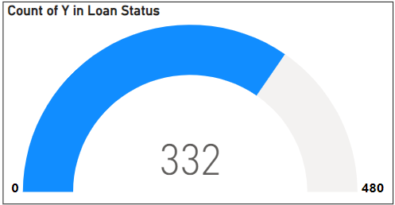
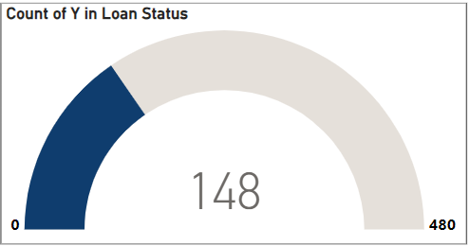
COUNT OF Y AND COUNT OF N IN LOAN STATUS
CountY = CALCULATE(COUNTROWS('loan_data_set'),'loan_data_set'[Loan_Status]="Y")
CountN = CALCULATE(COUNTROWS('loan_data_set'),'loan_data_set'[Loan_Status]="Y")

Slide 12
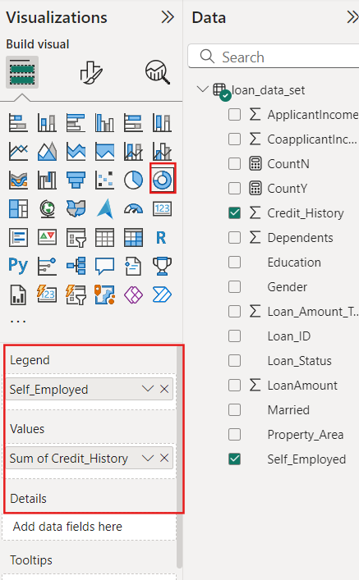
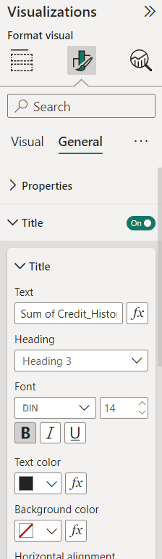
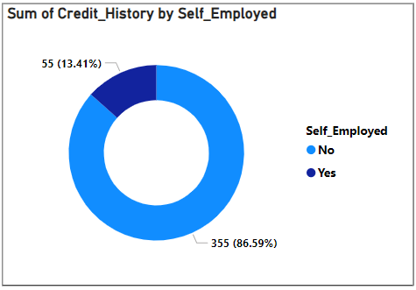
SUM OF CREDIT HISTORY BY SELF EMPLOYED
We select Doughnut chart.
Then drag self employed in legend and sum of credit history in values.
We can change the format of the visual.

Slide 13
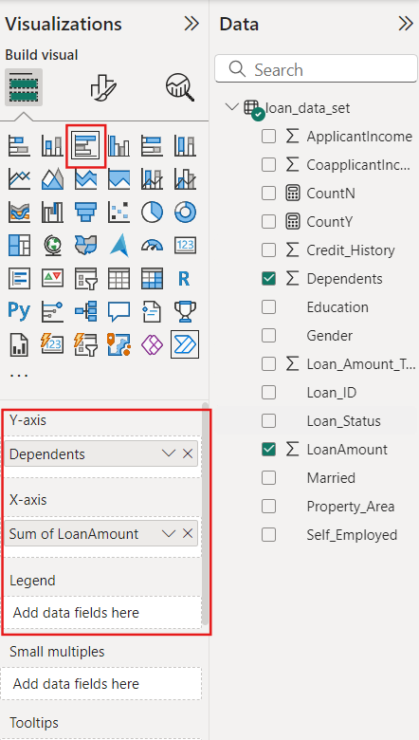
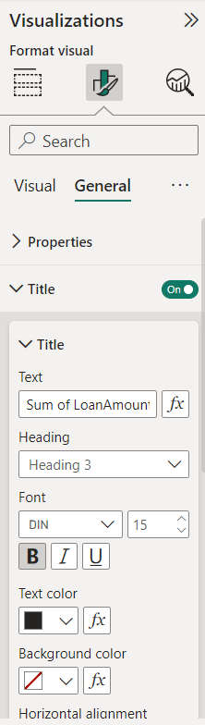
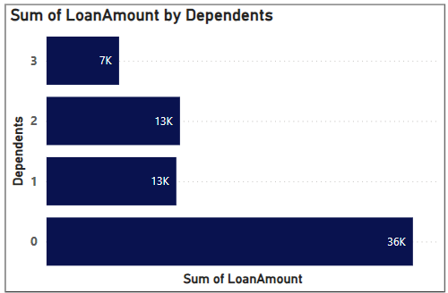
SUM OF LOAN AMOUNT BY DEPENDENTS
We select clustered bar chart.
Then drag dependent in the y axis and sum of loan amount in x axis.
We can change the format of the visual.

Slide 14
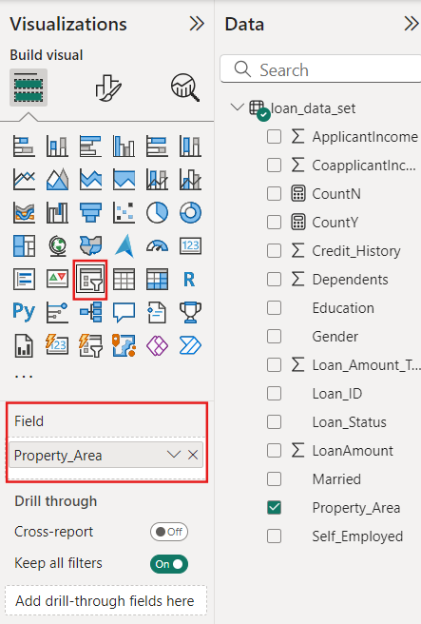
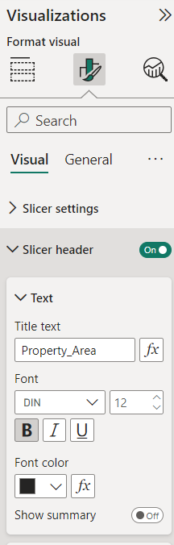
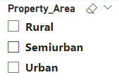
PROPERTY AREA SLICER
Now, we create a slicer.
Select slicer in visualizations, then drag property area in the field.
Format visual → Slicer settings → options → style → vertical list.

Slide 15
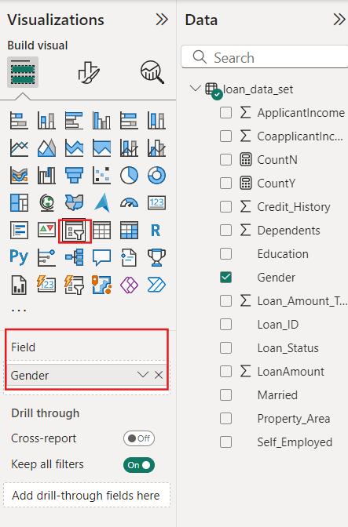
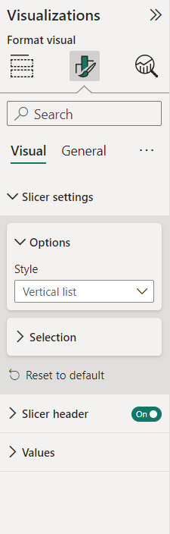
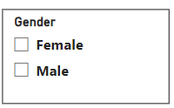
GENDER SLICER
Select slicer in visualizations, then drag gender in the field.
Format visual → Slicer settings → options → style → vertical list.

Slide 16

TITLE
Now, we add title.
Click Home → Text box
Type the text and we can change the size, font and color of the text.

Slide 17
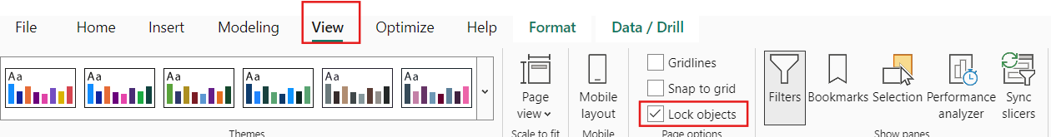
LOCK OBJECT
Then click view options and select lock objects so that the visualizations cannot move.

Slide 18
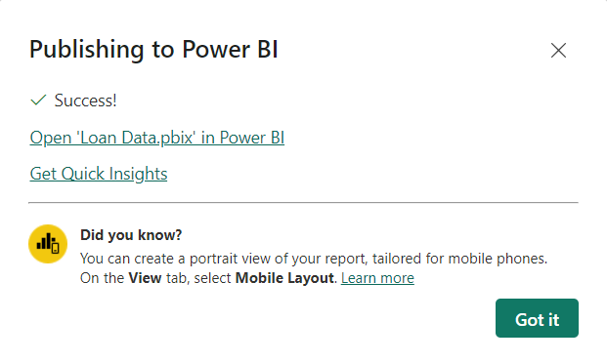
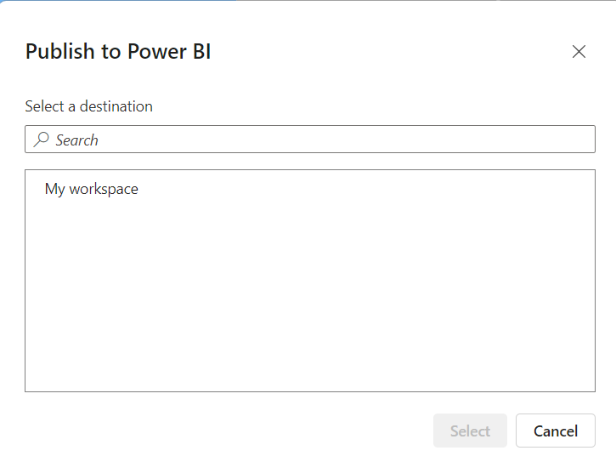
PUBLISH
Next click Home → Publish
Click My workspace → select
Then click open Loan Data.

Slide 19
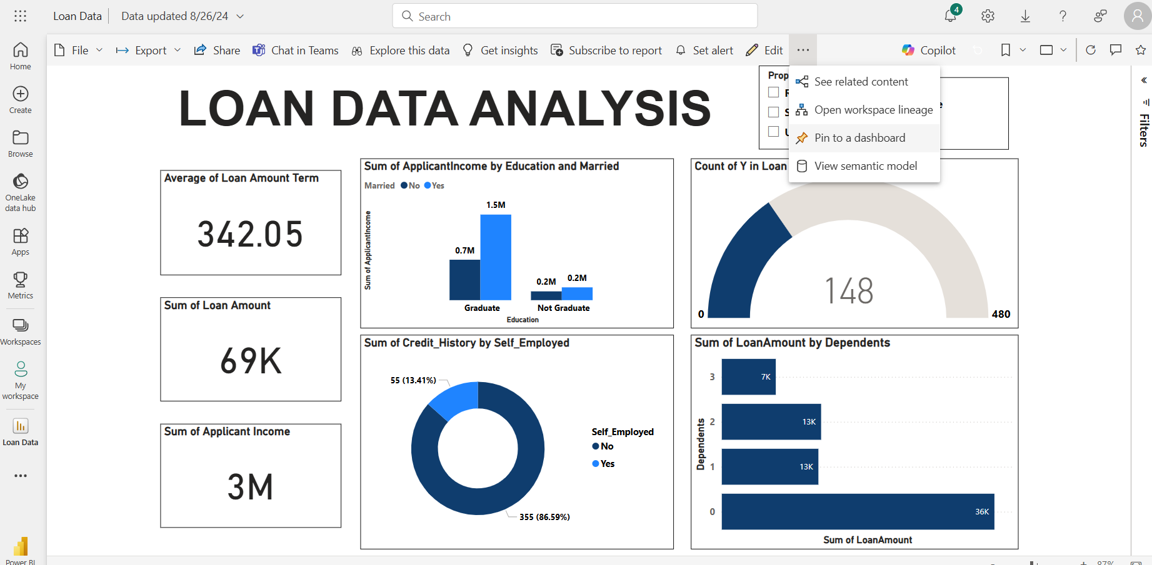
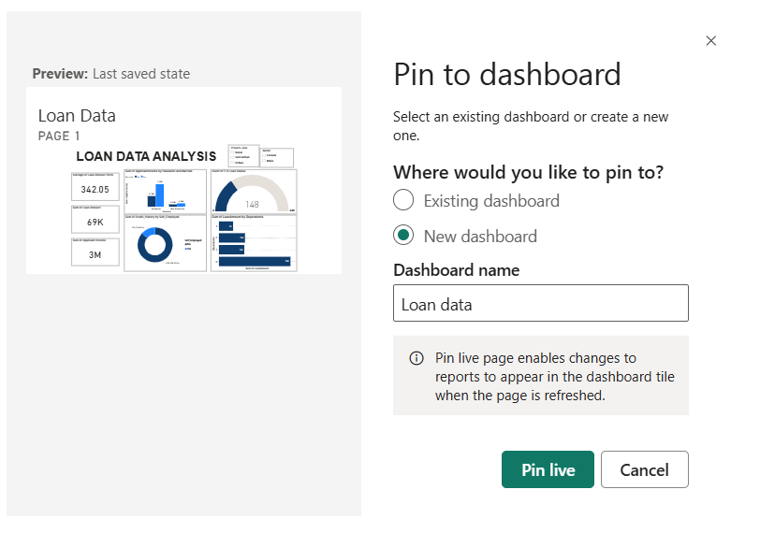
REPORT
Now, we got a report.
Next, click on the three dots → select pin to dashboard.
Then select existing dashboard or new dashboard and click pin live.

Slide 20
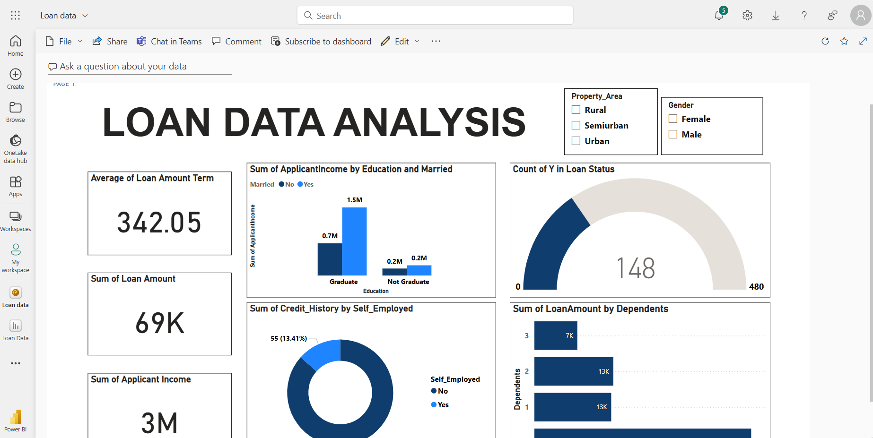
DASHBOARD

Slide 21
THANK YOU!

